Slide 1
Machine Learning Capstone
Machine Learning Fundamentals
Gordon McFadzean
13/11/2018

Slide 2
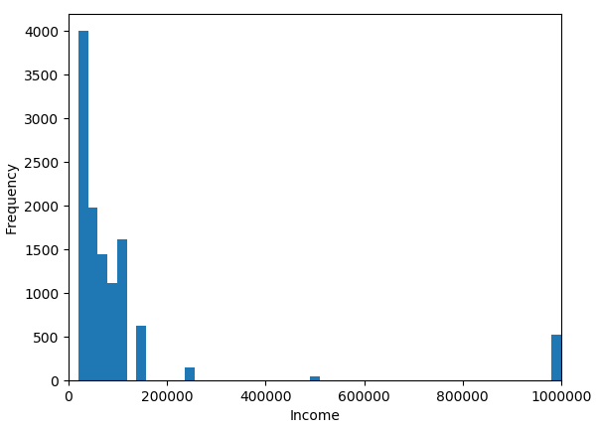
Income
The income data does not appear to be “continuous” – it looks like users are prompted to select the income from a dropdown which is closest to their own.
In addition, the vast majority of users – almost 48,000 – have a value of -1 for income, which seems to be a null entry.

Slide 3
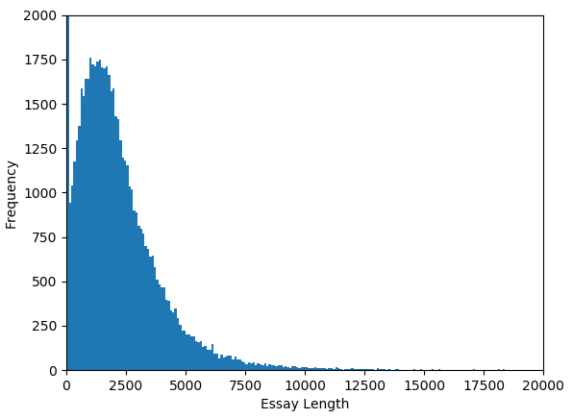
Total essay length
Most users write about 2000 characters in their essay response. There is a large spike at 0 – some people choose not to write anything!

Slide 4
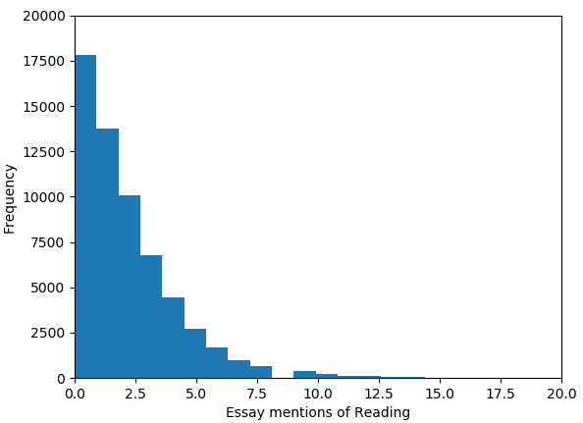
Essays mentions of books and reading
This was used by counting the number of types the string “book” or “read” appeared across all of a user’s essays.

Slide 5
Questions
Is there a link between certain answers relating to life style (diet, drinking etc) and body type?
Can information about people, including their education, income, and how they answered the essay questions, be used to predict their age?
I decided to examine two questions, based on the available data.

Slide 6
Diet mapping
Entry | code
mostly vegetarian | 1
vegetarian | 2
strictly vegetarian | 3
everything else | 0
Qualitative mappings were defined to quantify diets.
Similar mappings were established for vegan, halal, kosher, anything and other diets, as well as answers about drinking, drugs, and smoking.

Slide 7
Body type mapping
Entry | code
Average | 0
Fit | 1
Athletic | 1
Thin | 0
Curvy | 0
A little extra | 0
Skinny | 0
Full figured | 0
Overweight | 0
Jacked | 1
Used up | 0
Rather not say | 0
This mapping sets up a binary distinction between those who identify as “fit”, “athletic”, and “jacked” and everyone else.

Slide 8
Diet mapping
Entry | Graduated from | - | Working on | Dropped out
Phd programme | 5 | 5 | 4 | 4
Masters programme | 4 | 4 | 3 | 3
Law school | 4 | 4 | 3 | 3
Med school | 4 | 4 | 3 | 3
College/university | 3 | 3 | 1 | 1
Two-year college | 2 | 2 | 1 | 1
High school | 1 | 1 | 0 | 0
Space camp | 0 | 0 | 0 | 0
The mapping defines an ascending order of level of education, and also equivalency between different education levels.
This is highly subjective!

Slide 9
Classification comparison
 | K Nearest Neighbours | Support Vector Machine | Naïve Bayes
Accuracy | 54% | 57% | 56%
Recall | 47 | 25% | 1%
Precision | 49% | 54% | 54%
F1 | 48% | 34% | 2%
Run time | 1.2s | 17.5s | 0.01s
Three classification algorithms are used to determine whether we can predict whether someone identifies as “fit”, “athletic” or “jacked” based on info about their diet and lifestyle.
None of the models perform particularly well, although the K-Nearest Neighbours classification fares reasonably well. However, this is slightly more complex to set up, as it requires specification of an optimal value of k.
The other two struggle with very low recall scores, suggesting the model is not sensitive enough when classifying
The SVM model is also very slow compared to the others

Slide 10
Regression comparison
 | Linear Regression | K Nearest Neighbours Regression
R² | 14% | 11%
Run time | 0.01s | 0.35s
Two regression algorithms were used to compare the mapped “education code” against a number of factors – age, income, length of essays, the number of times essays mention books or reading, and a number of factors relating to lifestyle including how much they drink, smoke, take drugs, and whether they’re vegetarian or vegan.
Both these models do very poorly at predicting age, especially the k nearest neighbours regression model which actually has a negative R².
However, the data set does not be particularly well suited to simple regression analysis – most of the answers are categorical. More continuous data (e.g. BMI instead of body type, or “years in education” instead of education status) would facilitate more comprehensive regression analyses.

Slide 11
Summary
With an accuracy of over 50%, the answer for the first question appears to be yes. More quantitative data could probably help to improve this classification (e.g. “number of drinks per week”).
For the second, the models were not able to answer the question – the categorical data does not seem particularly well suited to these types of regression predictions. More complex analysis of the essay responses (natural language processing) could potentially allow for more complex models to be studied.
Is there a link between certain answers relating to life style (diet, drinking etc) and body type?
Can information about people, including their education, income, and how they answered the essay questions, be used to predict their age?

